Slide 1

Analysing Various Neighbourhood in Bangalore to Establish a Restaurant

Slide 2
Importance of Analysing a locality for a Business setup
Generally, a neighborhood is valued by its surroundings, services, popularity, population, transport networks etc. Therefore, area which improves a lot bring both competitive and economic advantages to the city.
Two of the most important and essential parameters to open a restaurant are finding a right location and type of the establishment.
The objective is to open a restaurant which is in an optimal and feasible location along with choosing right type or cuisine of restaurant which can make good profit and comparatively easy to operate.

Slide 3
Data acquisition and cleaning
The dataset containing pin code along with respective neighbourhood, latitude and longitude was extracted from https://data.gov.in/ website.
This huge dataset consisted data of every state and city present in India. Filter was applied on city column as Bangalore and resulting data was copied to another excel file.
As majority of pin-codes consist of one or more neighbourhood name, there were multiple entries, and this was solved by removing duplicates as we needed one pin-code along with its neighbourhood name and location details.
Details of venues and respective ratings were extracted from foursquare API using appropriate GET command along with URL of form; 'https://api.foursquare.com/v2/venues/explore?&client_id={}&client_secret={}&v={}&ll={},{}&radius={}&limit={}'

Slide 4
Methodology
Following steps are carried out
Convert addresses into their equivalent latitude and longitude values.
Use the Foursquare API to explore neighbourhoods in Bangalore City.
Use the explore function to get the most common venue categories in each neighbourhood, and then use this feature to group the neighbourhoods into clusters.
Use the k-means clustering algorithm to complete this task.
Use the Folium library to visualize the neighbourhoods in New York City and their emerging clusters.

Slide 5
Importing Libraries:
Numpy - library to handle data in a vectorized manner
Pandas - library for data analysis
Json - library to handle JSON files
Nominatim - convert an address into latitude and longitude values
Requests - library to handle requests
matplotlib.cm, matplotlib.colors - Matplotlib and associated plotting modules
KMeans - for clustering
Folium - map rendering library

Slide 6
Importing Data:
Data is imported in IBM Watson Studio and automatically code is generated to save the values into data frames using pandas library. Exploring the data it can be seen that columns are similar to excel file and an extra missing value column having values NaN was created and later dropped using drop command.

Slide 7
Use geopy library to get the latitude and longitude values of Bangalore City:
In order to define an instance of the geocoder, we need to define a user_agent. We will name our agent nyblr_explorer.
Next a map of Bangalore with neighbourhoods superimposed on top was created using Folium.
For illustration purposes, we simplify the map by segmenting and clustering only the neighbourhoods in Yelahanka new town area.
We slice the original dataframe and create a new dataframe of the Yelahanka new town data. As we did with all of Bangalore City and visualize Yelahanka new town and neighbourhoods in it.

Slide 8
Define Foursquare Credentials and Version:
Next, we utilize the Foursquare API to explore the neighbourhoods and segment them.
First we get the neighbourhood's name and then the neighbourhood's latitude and longitude values.
Then we get the top 100 venues that are in Yelahanka new town within a radius of 500 meters.
Next we send the GET request and examine the results.
We are ready to clean the json and structure it into a pandas dataframe and check how many venues were returned by Foursquare.

Slide 9
Explore Neighbourhoods in Yelahanka new town:
We create a function to repeat the same process to all the neighbourhoods in Yelahanka new town.
Then we write the code to run the above function on each neighbourhood and create a new dataframe called yelahanka_venues and then check the size of the resulting dataframe.
Next we check how many venues were returned for each neighbourhood and then find out how many unique categories can be curated from all the returned venues.

Slide 10
Analyze Each Neighbourhood:
First we start with one hot encoding. Next, we group rows by neighbourhood and by taking the mean of the frequency of occurrence of each category.
Then print each neighbourhood along with the top 5 most common venues and put that into a pandas dataframe.
Function to sort the venues in descending order was written and new dataframe and display the top 10 venues for each neighbourhood was created.

Slide 11
Cluster Neighbourhoods:
Final step is to Run k-means to cluster the neighbourhood into 5 clusters. And then we create a new data frame that includes the cluster as well as the top 10 venues for each neighbourhood. Finally, the resulting clusters is visualized.

Slide 12
Results
We examine each cluster and determine the discriminating venue categories that distinguish each cluster. Based on the defining categories, you can then assign a name to each cluster. Let us name them Cluster 1 to 5 for easy understanding.

Slide 13
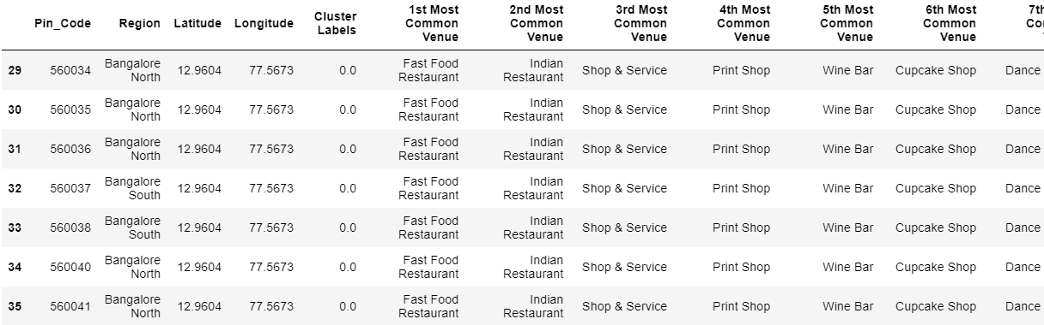
Cluster 1
For cluster 1 most popular type of venue is fast food restaurant followed by Indian restaurant. And least common venue is dessert shop.

Slide 14
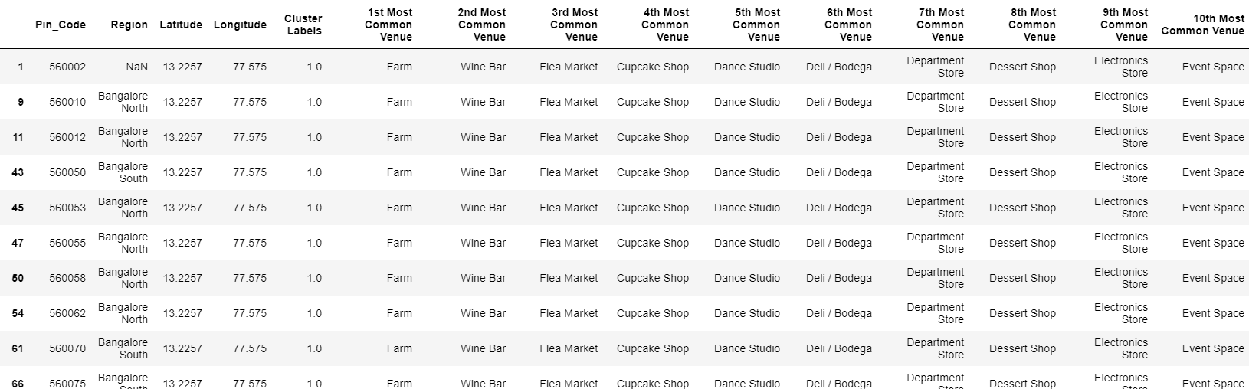
Cluster 2
Similarly in case of cluster 2 most common venue is farm, followed by wine bar and the least common spot visited by crowd are event spaces.

Slide 15
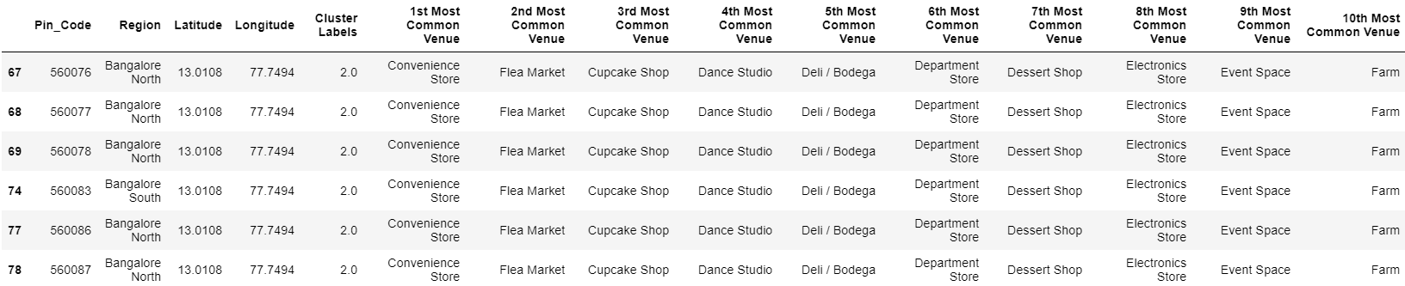
Cluster 3
In case of cluster 3, which lies in the outskirts of Bangalore, most common venue visited are the Convenience stores and next most common visited place is flea market. The least favourite venue is the farm.

Slide 16
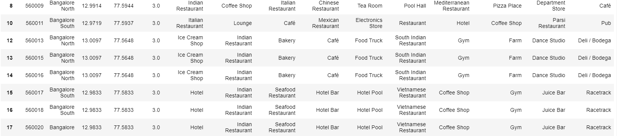
Cluster 4
Cluster 4 is the most important one for us. This cluster covers the area where we wish to establish our restaurant i.e Yelahanka new town. The most favourite venue visited here are Indian restaurant and followed by pizza place and hotels. Least visited place is hockey arena.

Slide 17
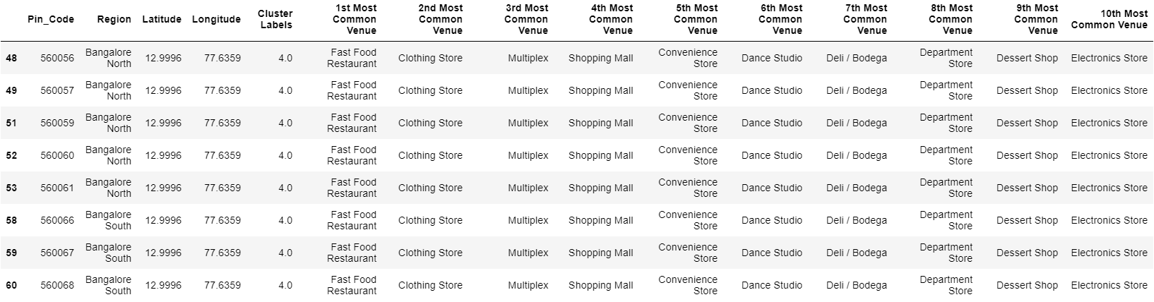
Cluster 5
In case of cluster 5 , fast food restaurant is preferred the most. Followed by clothing store and multiplexes. Electronics store takes the last position.

Slide 18
Conclusion
The basic parameter is the location and deciding type of restaurant. This project helps us in analysing these issues and draw a conclusion based on machine learning method i.e k means clustering
The observations are imported from foursquare api which contains details of venues present in a neighbourhood. The neighbourhood is downloaded from government of India website which contains pin code along with latitude and longitude of areas present in Bangalore urban.
5 is value of k chosen for optimal solution and the venues are divided into 5 clusters. The visualization of clusters helps us decide whether the assumed location for establishment is feasible.
Later the outcomes of clustering helps in drawing a conclusion regarding what type of restaurant would be successful. Based on these parameters we have decided to open a coffee shop along with a bakery in Yelahanka new town area of Bangalore

